Slide 1
SORTING ALGORITHMS
Prof. Zhenyu He
Harbin Institute of Technology, Shenzhen

Slide 2
OUTLINE
Why We Do Sorting?
Review of Learned Sorting Algorithms
How Fast can We Sort so far?
Linear-Time Sorting Algorithms
Counting Sort
Radix Sort
Bucket Sort

Slide 3
WHY WE DO SORTING

Slide 4
WHY WE DO SORTING?
Commonly encountered programming task in computing.
Examples of sorting:
List containing exam scores sorted from Lowest to Highest or from Highest to Lowest
List Rank of Milk Powder Producer Brands in China from the Star to Notorious
List Search Results of a User Query by Relevance from the WWW.

Slide 5
WHY WE DO SORTING?
Searching for an element in an array will be more efficient. (example: looking up for information like phone number).
It’s always nice to see data in a sorted display. (example: spreadsheet or database application).
Computers sort things much faster.

Slide 6
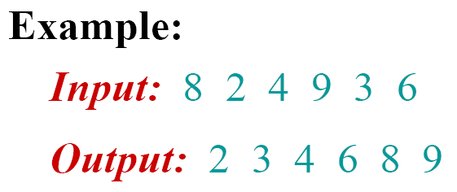
SORTING PROBLEM
Description:
Input: sequence of n numbers 〈a₁, a₂, …, a_{n}〉.
Output: A permutation 〈a'₁, a'₂, …, a'_{n}〉 such that a'₁ ≤ a'₂ ≤ … ≤ a'_{n} .

Slide 7
LEARNED SORTING ALGORITHMS

Slide 8
LEARNED SORTING ALGORITHMS
Selection Sort, Bubble Sort
Insertion Sort, Binary Insertion Sort, Shell Sort
Merge Sort, Heap Sort, Quick Sort

Slide 9
SHELL SORT
Shell sort
An algorithm that first beats the O(N²) barrier
Suitable performance for general use
Very popular
It is the basis of the default R sort() function
Tunable algorithm
Can use different orderings for comparisons

Slide 10
SHELL SORT
Donald L. Shell (1959)
A High-Speed Sorting Procedure
Communications of the Association for Computing
Machinery 2:30-32
Systems Analyst working at GE
Back then, most computers read punch-cards
Also called:
Diminishing increment sort
“Comb” sort
“Gap” sort

Slide 11
INTUITION
Insertion sort is effective:
For small datasets
For data that is nearly sorted
Insertion sort is inefficient when:
Elements must move far in array

Slide 12
THE IDEA …
Allow elements to move large steps
Bring elements close to final location
First, ensure array is nearly sorted …
then, run insertion sort …
How?
Sort interleaved arrays first

Slide 13
SHELL SORT RECIPE
Decreasing sequence of step sizes h
Every sequence must end at 1
… , 8, 4, 2, 1
For each h, sort sub-arrays that start at arbitrary
element and include every hth element
If h = 4
Sub-array with elements 1, 5, 9, 13 …
Sub-array with elements 2, 6, 10, 14 …
Sub-array with elements 3, 7, 11, 15 …
Sub-array with elements 4, 8, 12, 16 …

Slide 14
SHELL SORT NOTES
Any decreasing sequence that ends at 1 will do…
The final pass ensures array is sorted
Different sequences can dramatically increase (or decrease) performance
Code is similar to insertion sort

Slide 15
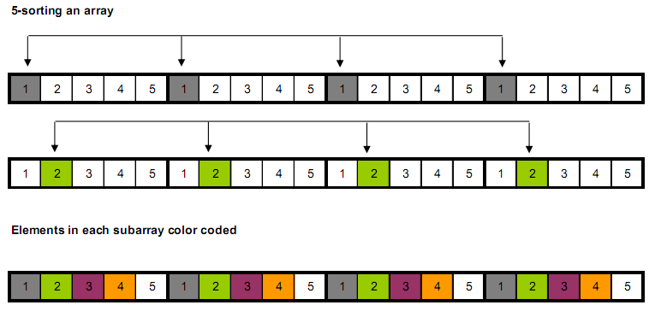
SUB-ARRAYS WHEN INCREMENT IS 5

Slide 16
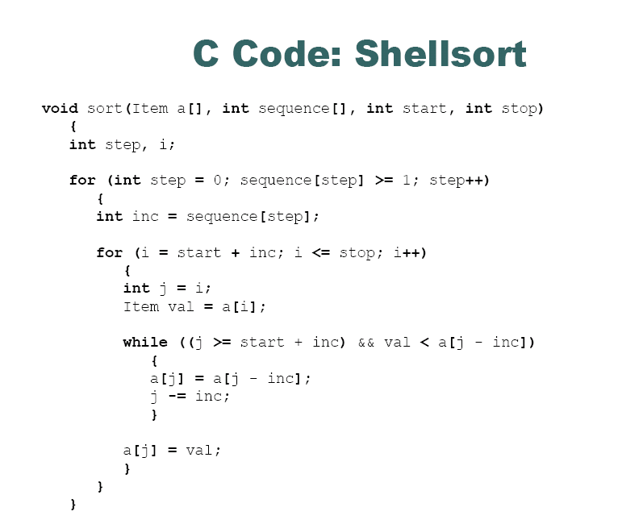

Slide 17
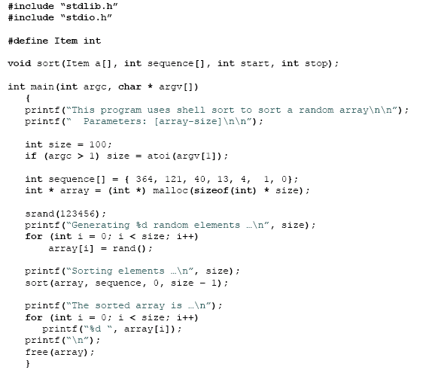

Slide 18
ANALYSIS OF SHELL SORT
The shell sort is still significantly slower than the merge, heap, and quick sorts, but its relatively simple algorithm makes it a good choice for sorting lists of less than 5000 items unless speed important. It's also an excellent choice for repetitive sorting of smaller lists.
For good increment sequences, requires time proportional to
O(N (log N)²) （n→∞）
O(N^{1.25})
5 times faster than the bubble sort and a little over twice as fast as the insertion sort, its closest competitor.

Slide 19
HOW FAST CAN WE SORT BY NOW

Slide 20
HOW FAST CAN WE SORT?
All the sorting algorithms we have seen so far are comparison sorts: only use comparisons to determine the relative order of elements.
E.g., insertion sort, merge sort, quicksort, heapsort.
The best worst-case running time that we’ve seen for comparison sorting is O(n lg n) .
Q:Is O(n lg n) the best we can do?
A: Yes, as long as we use comparison sorts
TODAY: Prove any comparison sort has
Ω(n lg n) worst case running time

Slide 21
THE TIME COMPLEXITY OF A PROBLEM
The minimum time needed by an algorithm to solve it.
Upper Bound:
Problem P is solvable in time T_{upper}(n)
if there is an algorithm A which
outputs the correct answer
in this much time
∃ A, ∀ I, A(I)=P(I) and Time(A,I) ≤ T_{upper}(|I|)
Time T_{lower}(n) is a lower bound for problem
if no algorithm solve the problem faster.
∀ A, ∃ I, A(I) = P(I) or Time(A,I) ≥ T_{lower}(|I|)
Lower Bound:

Slide 22
TODAY: PROVED A LOWER BOUND FOR ANY COMPARISON BASED ALGORITHM FOR THE SORTING PROBLEM
How?
Decision trees help us.

Slide 23
DECISION-TREE EXAMPLE
Sort ⟨a₁, a₂, …, a_{n}⟩
1:2
2:3
1:3
123
1:3
213
2:3
132
312
231
321
Each internal node is labeled i:j for i, j ∈ {1, 2,…, n}.
The left subtree shows subsequent comparisons if a_{i} ≤ a_{j}.
The right subtree shows subsequent comparisons if a_{i} ≥ a_{j}.

Slide 24
DECISION-TREE EXAMPLE
Sort ⟨a₁, a₂, a₃⟩ =
⟨ 9, 4, 6 ⟩:
1:2
9 ≥ 4
2:3
1:3
123
1:3
213
2:3
132
312
231
321
Each internal node is labeled i:j for i, j ∈ {1, 2,…, n}.
The left subtree shows subsequent comparisons if a_{i} ≤ a_{j}.
The right subtree shows subsequent comparisons if a_{i} ≥ a_{j}.

Slide 25
DECISION-TREE EXAMPLE
Sort ⟨a₁, a₂, a₃⟩ =
⟨ 9, 4, 6 ⟩:
1:2
2:3
1:3
9 ≥ 6
123
1:3
213
2:3
132
312
231
321
Each internal node is labeled i:j for i, j ∈ {1, 2,…, n}.
The left subtree shows subsequent comparisons if a_{i} ≤ a_{j}.
The right subtree shows subsequent comparisons if a_{i} ≥ a_{j}.

Slide 26
DECISION-TREE EXAMPLE
Sort ⟨a₁, a₂, a₃⟩ =
⟨ 9, 4, 6 ⟩:
1:2
2:3
1:3
123
1:3
213
2:3
4 ≤ 6
132
312
231
321
Each internal node is labeled i:j for i, j ∈ {1, 2,…, n}.
The left subtree shows subsequent comparisons if a_{i} ≤ a_{j}.
The right subtree shows subsequent comparisons if a_{i} ≥ a_{j}.

Slide 27
DECISION-TREE EXAMPLE
Sort ⟨a₁, a₂, a₃⟩ =
⟨ 9, 4, 6 ⟩:
1:2
2:3
1:3
123
1:3
213
2:3
132
312
231
321
4 ≤ 6 ≤ 9
Each leaf contains a permutation ⟨π(1), π(2),…, π(n)⟩ to indicate that the ordering a_{π(1)} ≤ a_{π(2)} ≤ ☹ ≤ a_{π(n)} has been established.

Slide 28
DECISION-TREE MODEL
A decision tree can model the execution of any comparison sort:
One tree for each input size n.
View the algorithm as splitting whenever it compares two elements.
The tree contains the comparisons along all possible instruction traces.
The running time of the algorithm = the length of the path taken.
Worst-case running time = height of tree.

Slide 29
Any comparison sort
Can be turned into a Decision tree
class InsertionSortAlgorithm {
for (int i = 1; i < a.length; i++) {
int j = i;
while ((j > 0) && (a[j-1] > a[i])) {
a[j] = a[j-1];
j--; }
a[j] = B; }}
1:2
2:3
1:3
123
1:3
213
2:3
132
312
231
321
What do the leaves represent?
How many leaves must there be?

Slide 30
LOWER BOUND FOR DECISION-TREE SORTING
Theorem. Any decision tree that can sort n elements must have height Ω(n lg n) .
What’s the minimum # of leaves?
What’s the maximum # of leaves of a binary tree of height h?
Clearly the minimum # of leaves is less than or equal to the maximum # of leaves
Proof. The tree must contain ≥ n! leaves, since there are n! possible permutations. A height-h binary tree has ≤ 2^{h} leaves. Thus, n! ≤ 2^{h} .

Slide 31
LOWER BOUND FOR DECISION-TREE SORTING
So we have… n! ≤ 2^{h}
Taking logarithms: lg (n!) ≤ h
Stirling’s approximation tells us:
Thus:

Slide 32
LOWER BOUND FOR COMPARISON SORTING
Corollary. Heapsort and merge sort are asymptotically optimal comparison sorting algorithms.

Slide 33
Sorting Lower Bound
Is there a faster algorithm? If different model of computation?
class InsertionSortAlgorithm {
for (int i = 1; i < a.length; i++) {
int j = i;
while ((j > 0) && (a[j-1] > a[i])) {
a[j] = a[j-1];
j--; }
a[j] = B; }}

Slide 34
LINEAR TIME SORTING ALGORITHMS

Slide 35
SORTING IN LINEAR TIME
Counting sort: No comparisons between elements.
Input: A[1 . . n], where A[ j]∈{1, 2, …, k} .
Output: B[1 . . n], sorted.
Auxiliary storage: C[1 . . k] .

Slide 36
COUNTING SORT
for i ← 1 to k
do C[i] ← 0
for j ← 1 to n
do C[A[ j]] ← C[A[ j]] + 1 ⊳ C[i] = |{key = i}|
for i ← 2 to k
do C[i] ← C[i] + C[i–1] ⊳ C[i] = |{key ≤ i}|
for j ← n down to 1
do B[C[A[ j]]] ← A[ j]
C[A[ j]] ← C[A[ j]] – 1

Slide 37
COUNTING-SORT EXAMPLE
1
2
3
4
5
1
2
3
4
A:
4
1
3
4
3
C:
B:

Slide 38
LOOP 1
1
2
3
4
5
1
2
3
4
A:
4
1
3
4
3
C:
0
0
0
0
B:
for i ← 1 to k
do C[i] ← 0

Slide 39
LOOP 2
1
2
3
4
5
1
2
3
4
A:
4
1
3
4
3
C:
0
0
0
1
B:
for j ← 1 to n
do C[A[ j]] ← C[A[ j]] + 1 ⊳ C[i] = |{key = i}|

Slide 40
LOOP 2
1
2
3
4
5
1
2
3
4
A:
4
1
3
4
3
C:
1
0
0
1
B:
for j ← 1 to n
do C[A[ j]] ← C[A[ j]] + 1 ⊳ C[i] = |{key = i}|

Slide 41
LOOP 2
1
2
3
4
5
1
2
3
4
A:
4
1
3
4
3
C:
1
0
1
1
B:
for j ← 1 to n
do C[A[ j]] ← C[A[ j]] + 1 ⊳ C[i] = |{key = i}|

Slide 42
LOOP 2
1
2
3
4
5
1
2
3
4
A:
4
1
3
4
3
C:
1
0
1
2
B:
for j ← 1 to n
do C[A[ j]] ← C[A[ j]] + 1 ⊳ C[i] = |{key = i}|

Slide 43
LOOP 2
1
2
3
4
5
1
2
3
4
A:
4
1
3
4
3
C:
1
0
2
2
B:
for j ← 1 to n
do C[A[ j]] ← C[A[ j]] + 1 ⊳ C[i] = |{key = i}|

Slide 44
LOOP 3
1
2
3
4
5
1
2
3
4
A:
4
1
3
4
3
C:
1
0
2
2
B:
C':
1
1
2
2
for i ← 2 to k
do C[i] ← C[i] + C[i–1] ⊳ C[i] = |{key ≤ i}|

Slide 45
LOOP 3
1
2
3
4
5
1
2
3
4
A:
4
1
3
4
3
C:
1
0
2
2
B:
C':
1
1
3
2
for i ← 2 to k
do C[i] ← C[i] + C[i–1] ⊳ C[i] = |{key ≤ i}|

Slide 46
LOOP 3
1
2
3
4
5
1
2
3
4
A:
4
1
3
4
3
C:
1
0
2
2
B:
C':
1
1
3
5
for i ← 2 to k
do C[i] ← C[i] + C[i–1] ⊳ C[i] = |{key ≤ i}|

Slide 47
LOOP 4
1
2
3
4
5
1
2
3
4
A:
4
1
3
4
3
C:
1
1
3
5
B:
3
C':
1
1
2
5
for j ← n down to 1
do B[C[A[ j]]] ← A[ j]
C[A[ j]] ← C[A[ j]] – 1

Slide 48
LOOP 4
1
2
3
4
5
1
2
3
4
A:
4
1
3
4
3
C:
1
1
2
5
B:
3
4
C':
1
1
2
4
for j ← n down to 1
do B[C[A[ j]]] ← A[ j]
C[A[ j]] ← C[A[ j]] – 1

Slide 49
LOOP 4
1
2
3
4
5
1
2
3
4
A:
4
1
3
4
3
C:
1
1
2
4
B:
3
3
4
C':
1
1
1
4
for j ← n down to 1
do B[C[A[ j]]] ← A[ j]
C[A[ j]] ← C[A[ j]] – 1

Slide 50
LOOP 4
1
2
3
4
5
1
2
3
4
A:
4
1
3
4
3
C:
1
1
1
4
B:
1
3
3
4
C':
0
1
1
4
for j ← n down to 1
do B[C[A[ j]]] ← A[ j]
C[A[ j]] ← C[A[ j]] – 1

Slide 51
LOOP 4
1
2
3
4
5
1
2
3
4
A:
4
1
3
4
3
C:
0
1
1
4
B:
1
3
3
4
4
C':
0
1
1
3
for j ← n down to 1
do B[C[A[ j]]] ← A[ j]
C[A[ j]] ← C[A[ j]] – 1

Slide 52
ANALYSIS
for i ← 1 to k
do C[i] ← 0
Θ(k)
for j ← 1 to n
do C[A[ j]] ← C[A[ j]] + 1
Θ(n)
for i ← 2 to k
do C[i] ← C[i] + C[i–1]
Θ(k)
for j ← n down to 1
do B[C[A[ j]]] ← A[ j]
C[A[ j]] ← C[A[ j]] – 1
Θ(n)
Θ(n + k)

Slide 53
RUNNING TIME
If k = O(n), then counting sort takes Θ(n) time.
But, sorting takes Ω(n lg n) time!
Where’s the fallacy?
Answer:
Comparison sorting takes Ω(n lg n) time.
Counting sort is not a comparison sort.
In fact, not a single comparison between elements occurs!

Slide 54
STABLE SORTING
Counting sort is a stable sort: it preserves the input order among equal elements.
A:
4
1
3
4
3
B:
1
3
3
4
4
Exercise: What other sorts have this property?

Slide 55
COUNTING SORT
Why don’t we always use counting sort?
Because it depends on range k of elements
Could we use counting sort to sort 32 bit integers? Why or why not?
Answer: no, k too large (2³² = 4,294,967,296)

Slide 56
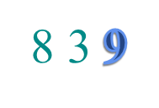
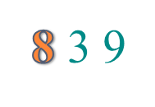
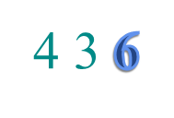
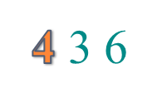
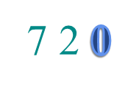

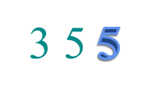
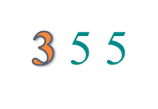
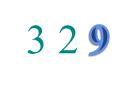
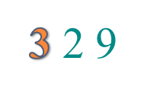
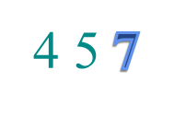
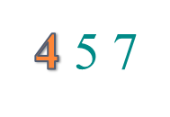
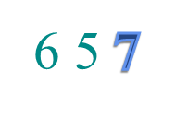

IMPROVEMENT BY RADIX SORT
In fact, each number is composed of digits.
The range of each digit is limited.
We can run counting sort on each digit.
8 3 9
4 3 6
7 2 0
3 5 5
3 2 9
4 5 7
6 5 7

Slide 57
RADIX SORT
Origin: Herman Hollerith’s card-sorting machine for the 1890 U.S. Census.
Digit-by-digit sort.
Hollerith’s original (bad) idea: sort on most-significant digit first.
Good idea: Sort on least-significant digit first with auxiliary stable sort.

Slide 58
OPERATION OF RADIX SORT
3 2 9
7 2 0
7 2 0
3 2 9
4 5 7
3 5 5
3 2 9
3 5 5
6 5 7
4 3 6
4 3 6
4 3 6
8 3 9
4 5 7
8 3 9
4 5 7
4 3 6
6 5 7
3 5 5
6 5 7
7 2 0
3 2 9
4 5 7
7 2 0
3 5 5
8 3 9
6 5 7
8 3 9

Slide 59
CORRECTNESS OF RADIX SORT
Induction on digit position
Assume that the numbers are sorted by their low-order t – 1 digits.
7 2 0
3 2 9
3 2 9
3 5 5
4 3 6
4 3 6
8 3 9
4 5 7
Sort on digit t
3 5 5
6 5 7
4 5 7
7 2 0
6 5 7
8 3 9

Slide 60
CORRECTNESS OF RADIX SORT
Induction on digit position
Assume that the numbers are sorted by their low-order t – 1 digits.
7 2 0
3 2 9
3 2 9
3 5 5
4 3 6
4 3 6
8 3 9
4 5 7
Two numbers that differ in digit t are correctly sorted.
Sort on digit t
3 5 5
6 5 7
4 5 7
7 2 0
6 5 7
8 3 9

Slide 61
CORRECTNESS OF RADIX SORT
Induction on digit position
Assume that the numbers are sorted by their low-order t – 1 digits.
7 2 0
3 2 9
3 2 9
3 5 5
4 3 6
4 3 6
8 3 9
4 5 7
Sort on digit t
Two numbers that differ in digit t are correctly sorted.
3 5 5
6 5 7
4 5 7
7 2 0
Two numbers equal in digit t are put in the same order as the input ⇒ correct order.
6 5 7
8 3 9

Slide 62
ANALYSIS OF RADIX SORT
Assume counting sort is the auxiliary stable sort.
Sort n computer words of b bits each.
Each word can be viewed as having b/r base-2^{r} digits.
8
8
8
8
Example: 32-bit word
r = 8 ⇒ b/r = 4 passes of counting sort on base-2⁸ digits; or r = 16 ⇒ b/r = 2 passes of counting sort on base-2¹⁶ digits.
How many passes should we make?

Slide 63
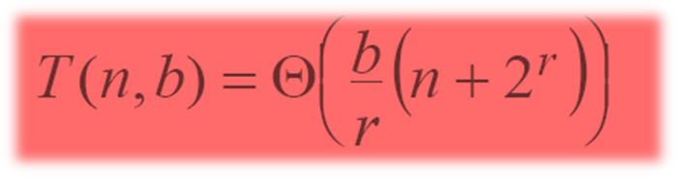
ANALYSIS (CONTINUED)
Recall: Counting sort takes Θ(n + k) time to sort n numbers in the range from 0 to k – 1.
If each b-bit word is broken into r-bit pieces, each pass of counting sort takes Θ(n + 2^{r}) time. Since there are b/r passes, we have
.
Choose r to minimize T(n, b):
Increasing r means fewer passes, but as r > lg n, the time grows exponentially.
>

Slide 64
ANALYSIS (CONTINUED)
Minimize T(n, b) by differentiating and setting to 0.
Or, just observe that we don’t want 2^{r} > n, and there’s no harm asymptotically in choosing r as large as possible subject to this constraint.
>
Choosing r = lg n implies T(n, b) = Θ(b n/lg n) .
For numbers in the range from 0 to n ^{d} – 1, we have b = d lg n ⇒ radix sort runs in Θ(d n) time.

Slide 65
CONCLUSIONS
In practice, radix sort is fast for large inputs, as well as simple to code and maintain.
Example (32-bit numbers):
At most 3 passes when sorting ≥ 2000 numbers.
Merge sort and quick sort do at least ⎡lg 2000⎤ = 11 passes.
Downside: Can’t sort in place using counting sort. Also, Unlike quick sort, radix sort displays little locality of reference, and thus a well-tuned quick sort fares better sometimes on modern processors, with steep memory hierarchies.

Slide 66
ORIGIN OF RADIX SORT
Hollerith’s original 1889 patent alludes to a most-significant-digit-first radix sort:
“The most complicated combinations can readily be counted with comparatively few counters or relays by first assorting the cards according to the first items entering into the combinations, then resorting each group according to the second item entering into the combination, and so on, and finally counting on a few counters the last item of the combination for each group of cards.”
Least-significant-digit-first radix sort seems to be a folk invention originated by machine operators.

Slide 67
BUCKET SORT
In Bucket sort, the range [a,b] of input numbers is divided into m equal sized intervals, called buckets.
Each element is placed in its appropriate bucket.
If the numbers are uniformly divided in the range, the buckets can be expected to have roughly identical number of elements.
Elements in the buckets are locally sorted.
The expected time of this algorithm is Θ(n).

Slide 68
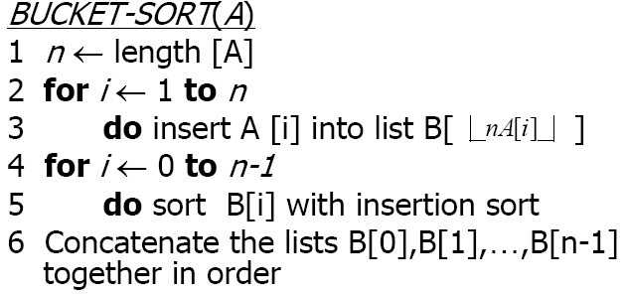

Slide 69
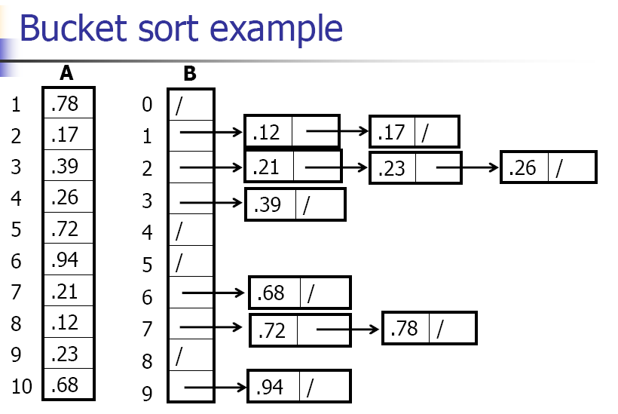

Slide 70
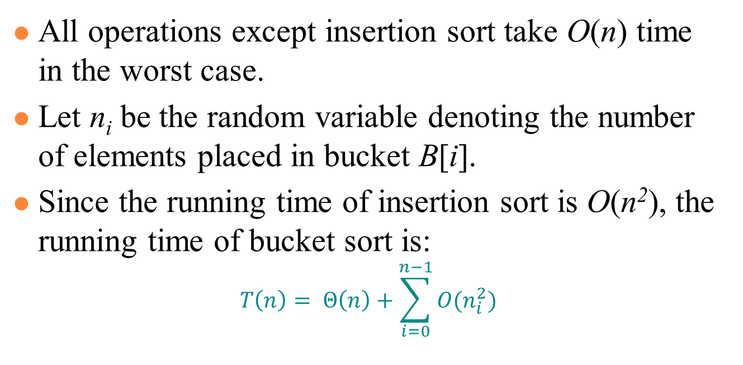
ANALYSIS OF BUCKET SORT

Slide 71
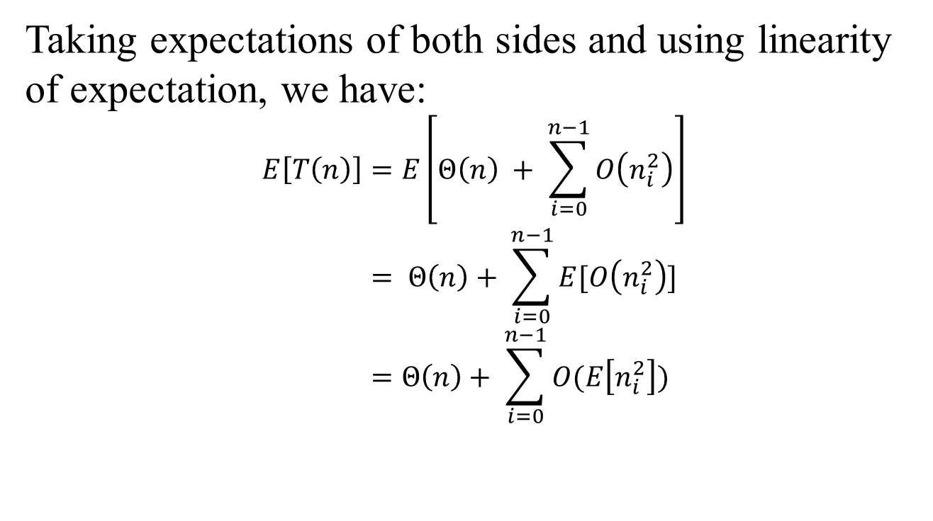
ANALYSIS OF BUCKET SORT

Slide 72
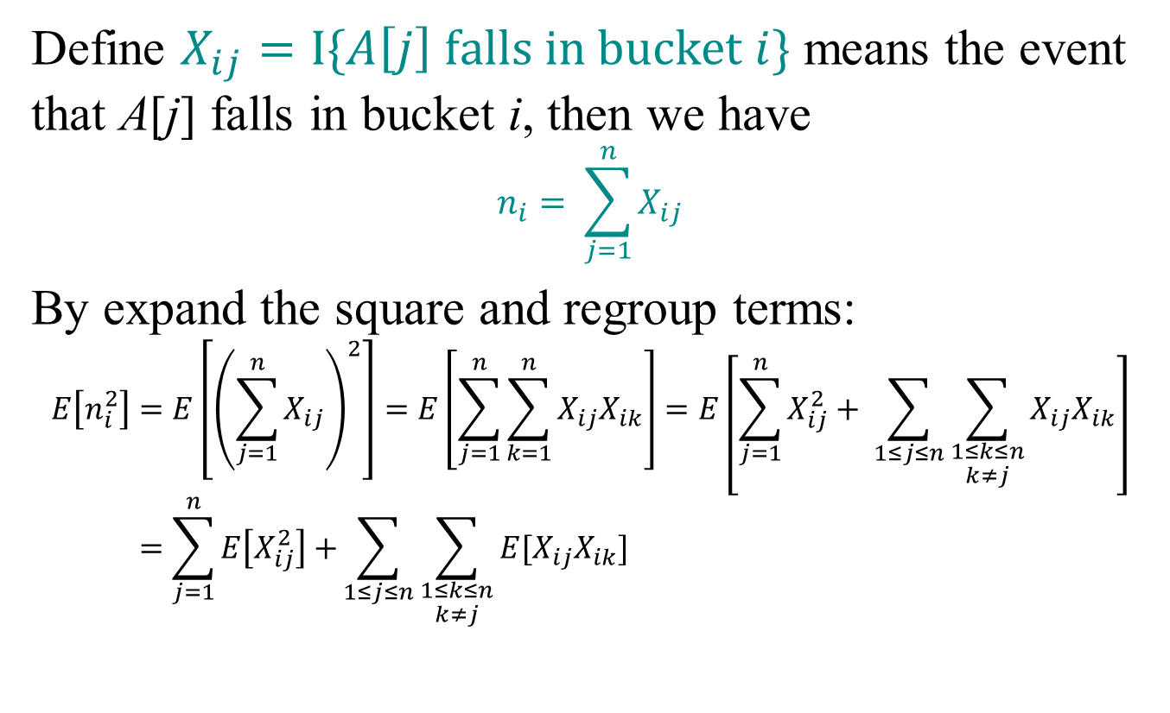
ANALYSIS OF BUCKET SORT

Slide 73
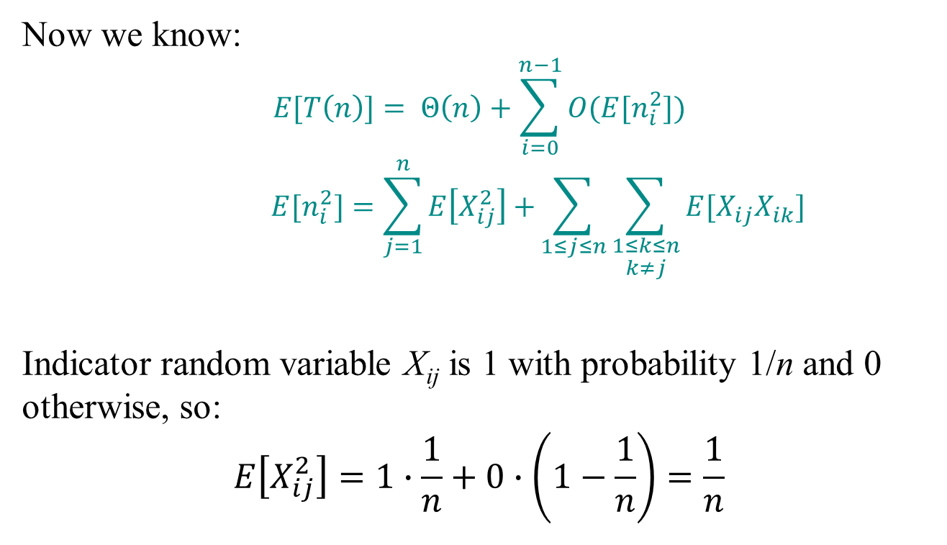
ANALYSIS OF BUCKET SORT

Slide 74
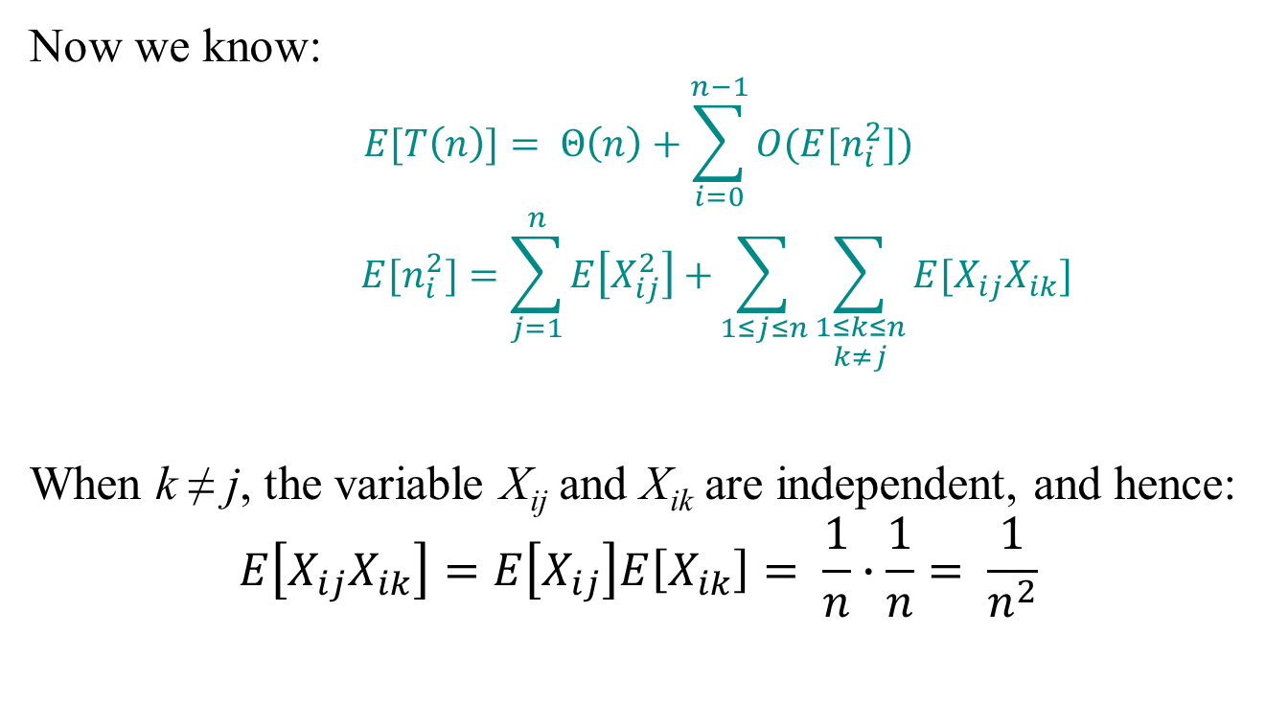
ANALYSIS OF BUCKET SORT

Slide 75
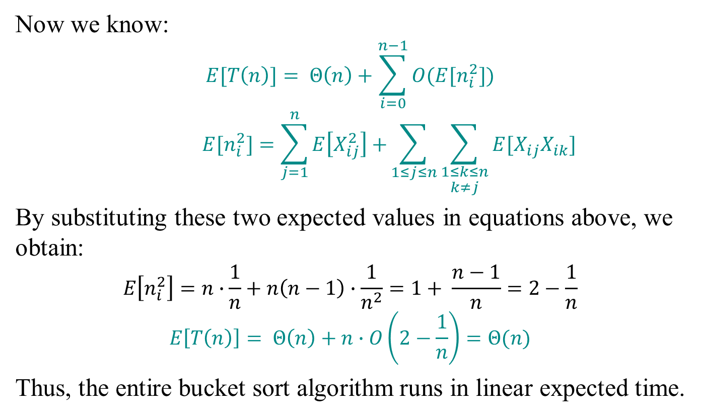
ANALYSIS OF BUCKET SORT

